Slide 1
Graph Algorithms Shortest Path
CS 325

Slide 2
Shortest-Path Problems
Shortest-Path problems
Single-source (single-destination). Find a shortest path from a given source (vertex s) to each of the vertices. The topic of this lecture.
Single-pair. Given two vertices, find a shortest path between them. Solution to single-source problem solves this problem efficiently, too.
All-pairs. Find shortest-paths for every pair of vertices. Dynamic programming algorithm.
Unweighted shortest-paths – BFS.

Slide 3
Shortest Path
Generalize distance to weighted setting
Digraph G = (V,E) with weight function W: E → R (assigning real values to edges)
Weight of path p = v₁ → v₂ → … → v_{k} is
Shortest path = a path of the minimum weight

Slide 4
Single-Source Shortest Path
Problem: given a weighted directed graph G, find the minimum-weight path from a given source vertex s to another vertex v
“Shortest-path” = minimum weight
Weight of path is sum of edges

Slide 5
Shortest Path Properties
Again, we have optimal substructure: the shortest path consists of shortest subpaths:
Proof: suppose some subpath is not a shortest path
There must then exist a shorter subpath
Could substitute the shorter subpath for a shorter path
But then overall path is not shortest path. Contradiction

Slide 6
Shortest Path Properties
Define δ(u,v) to be the weight of the shortest path from u to v
Shortest paths satisfy the triangle inequality: δ(u,v) ≤ δ(u,x) + δ(x,v)
x
u
v
This path is no longer than any other path

Slide 7
Shortest Path Properties
In graphs with negative weight cycles, some shortest paths will not exist
< 0

Slide 8
Negative Weights and Cycles?
Negative edges are OK, as long as there are no negative weight cycles (otherwise paths with arbitrary small “lengths” would be possible)
Shortest-paths can have no cycles (otherwise we could improve them by removing cycles)
Any shortest-path in graph G can be no longer than n–1 edges, where n is the number of vertices

Slide 9
Relaxation
A key technique in shortest path algorithms is relaxation
Idea: for all v, maintain upper bound d[v] on δ(s,v)
Relax(u,v,w) {
if (d[v] > d[u]+w(u,v)) then
d[v]=d[u]+w(u,v);
}
5
2
9
5
2
6
u
Relax
v
u
Relax
v
5
2
7
5
2
6

Slide 10
Dijkstra's algorithm
A solution to the single-source shortest path problem in graph theory.
Works on both directed and undirected graphs. However, all edges must have nonnegative weights.
Approach: Greedy
Input: Weighted graph G={E,V} and source vertex v∈V, such that all edge weights are nonnegative
Output: Lengths of shortest paths (or the shortest paths themselves) from a given source vertex v∈V to all other vertices

Slide 11
Dijkstra’s Algorithm - SSSP-Dijkstra
Dijkstra(G, w, s)
InitializeSingleSource(G, s)
S ← ∅
Q ← V[G]
while Q ≠ 0 do
u ← ExtractMin(Q)
S ← S ∪ {u}
for v ∈ Adj[u] do
Relax(u,v,w)
InitializeSingleSource(G, s)
for v ∈ V[G] do
d[v] ← ∞
p[v] ← 0
d[s] ← 0

Slide 12
Example
2
Initialize array
F
3
5
C
 | S | d_{v} | p_{v}
A | F | ∞ | −
B | F | ∞ | −
C | F | ∞ | −
D | F | ∞ | −
E | F | ∞ | −
F | F | ∞ | −
G | F | ∞ | −
H | F | ∞ | −
A
10
7
3
8
4
4
B
18
D
9
10
H
2
9
25
3
G
E
7

Slide 13
2
Start with G
F
3
5
C
 | S | d_{v} | p_{v}
A
B
C
D
E
F
G | T | 0 | −
H
A
10
7
3
8
4
4
B
18
D
9
10
H
2
9
25
3
G
E
7

Slide 14
2
Update unselected nodes
F
3
5
C
 | S | d_{v} | p_{v}
A
B
C
D |  | 2 | G
E
F
G | T | 0 | −
H |  | 3 | G
A
10
7
3
8
4
4
B
18
D
9
10
H
2
9
25
3
G
E
7

Slide 15
2
Select minimum distance
F
3
5
C
 | S | d_{v} | p_{v}
A
B
C
D | T | 2 | G
E
F
G | T | 0 | −
H |  | 3 | G
A
10
7
3
8
4
4
B
18
D
9
10
H
2
9
25
3
G
E
7

Slide 16
2
Update unselected nodes
F
3
5
C
 | S | d_{v} | p_{v}
A
B
C
D | T | 2 | G
E |  | 27 | D
F |  | 20 | D
G | T | 0 | −
H |  | 3 | G
A
10
7
3
8
4
4
B
18
D
9
10
H
2
9
25
3
G
E
7

Slide 17
2
Select minimum distance
F
3
5
C
 | S | d_{v} | p_{v}
A
B
C
D | T | 2 | G
E |  | 27 | D
F |  | 20 | D
G | T | 0 | −
H | T | 3 | G
A
10
7
3
8
4
4
B
18
D
9
10
H
2
9
25
3
G
E
7

Slide 18
2
Update unselected nodes
F
3
5
C
 | S | d_{v} | p_{v}
A |  | 7 | H
B |  | 12 | H
C
D | T | 2 | G
E |  | 27 | D
F |  | 20 | D
G | T | 0 | −
H | T | 3 | G
A
10
7
3
8
4
4
B
18
D
9
10
H
2
9
25
3
G
E
7

Slide 19
2
Select minimum distance
F
3
5
C
 | S | d_{v} | p_{v}
A | T | 7 | H
B |  | 12 | H
C
D | T | 2 | G
E |  | 27 | D
F |  | 20 | D
G | T | 0 | −
H | T | 3 | G
A
10
7
3
8
4
4
B
18
D
9
10
H
2
9
25
3
G
E
7

Slide 20
2
Update unselected nodes
F
3
5
C
 | S | d_{v} | p_{v}
A | T | 7 | H
B |  | 12 | H
C
D | T | 2 | G
E |  | 27 | D
F |  | 17 | A
G | T | 0 | −
H | T | 3 | G
A
10
7
3
8
4
4
B
18
D
9
10
H
2
9
25
3
G
E
7

Slide 21
2
Select minimum distance
F
3
5
C
 | S | d_{v} | p_{v}
A | T | 7 | H
B | T | 12 | H
C
D | T | 2 | G
E |  | 27 | D
F |  | 17 | A
G | T | 0 | −
H | T | 3 | G
A
10
7
3
8
4
4
B
18
D
9
10
H
2
9
25
3
G
E
7

Slide 22
2
Update unselected nodes
F
3
5
C
 | S | d_{v} | p_{v}
A | T | 7 | H
B | T | 12 | H
C |  | 16 | B
D | T | 2 | G
E |  | 22 | B
F |  | 17 | A
G | T | 0 | −
H | T | 3 | G
A
10
7
3
8
4
4
B
18
D
9
10
H
2
9
25
3
G
E
7

Slide 23
2
Select minimum distance
F
3
5
C
 | S | d_{v} | p_{v}
A | T | 7 | H
B | T | 12 | H
C | T | 16 | B
D | T | 2 | G
E |  | 22 | B
F |  | 17 | A
G | T | 0 | −
H | T | 3 | G
A
10
7
3
8
4
4
B
18
D
9
10
H
2
9
25
3
G
E
7

Slide 24
2
Update unselected nodes
F
3
5
C
 | S | d_{v} | p_{v}
A | T | 7 | H
B | T | 12 | H
C | T | 16 | B
D | T | 2 | G
E |  | 22 | B
F |  | 17 | A
G | T | 0 | −
H | T | 3 | G
A
10
7
3
8
4
4
B
18
D
9
10
H
2
9
25
3
G
E
7

Slide 25
2
Select minimum distance
F
3
5
C
 | S | d_{v} | p_{v}
A | T | 7 | H
B | T | 12 | H
C | T | 16 | B
D | T | 2 | G
E |  | 22 | B
F | T | 17 | A
G | T | 0 | −
H | T | 3 | G
A
10
7
3
8
4
4
B
18
D
9
10
H
2
9
25
3
G
E
7

Slide 26
2
Update unselected nodes
F
3
5
C
 | S | d_{v} | p_{v}
A | T | 7 | H
B | T | 12 | H
C | T | 16 | B
D | T | 2 | G
E |  | 19 | F
F | T | 17 | A
G | T | 0 | −
H | T | 3 | G
A
10
7
8
4
4
B
18
D
9
10
H
2
9
25
3
G
E
7

Slide 27
2
Select minimum distance
F
3
5
C
 | S | d_{v} | p_{v}
A | T | 7 | H
B | T | 12 | H
C | T | 16 | B
D | T | 2 | G
E | T | 19 | F
F | T | 17 | A
G | T | 0 | −
H | T | 3 | G
A
10
7
8
4
4
B
18
D
9
10
H
2
9
25
3
G
E
7
Done

Slide 28
Complexity
Analysis
findMin() takes O(V) time
outer loop iterates (V-1) times
➔ O(V²) time
Optimal for dense graphs, i.e., |E| = O(V²)
Suboptimal for sparse graphs, i.e., |E| = O(V)

Slide 29
Dijkstra’s - Complexity
SSSP-Dijkstra(G, w, s)
InitializeSingleSource(G, s)
S ← ∅
Q ← V[G]
while Q ≠ 0 do
u ← ExtractMin(Q)
S ← S ∪ {u}
for u ∈ Adj[u] do
Relax(u,v,w)
executed Θ(V) times
Θ(E) times in total
InitializeSingleSource(G, s)
for v ∈ V[G] do
d[v] ← ∞
p[v] ← 0
d[s] ← 0
Θ(V)
Relax(u, v, w)
if d[v] > d[u] + w(u,v) then
d[v] ← d[u] + w(u,v)
p[v] ← u
Θ(1) ?

Slide 30
Dijkstra’s Running Time
Extract-Min executed |V| time
Decrease-Key (Relax) executed |E| time
Time = |V| T_{Extract-Min} + |E| T_{Decrease-Key}
T depends on different Q implementations
Prority Queue | Extract-Min | Decrease-Key | Total
array | Ο(V) | Ο(1) | Ο(V ²)
binary heap | Ο(lg V) | Ο(lg V) | Ο(E lg V)
Fibonacci heap | Ο(lg V) | Ο(1) (amort.) | Ο(V lgV + E)

Slide 31
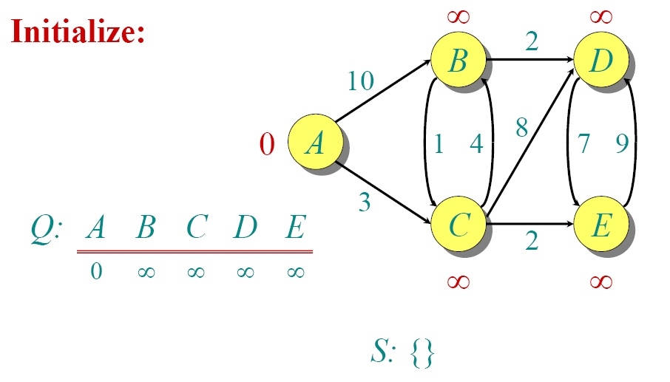
Dijkstra Another Example

Slide 32
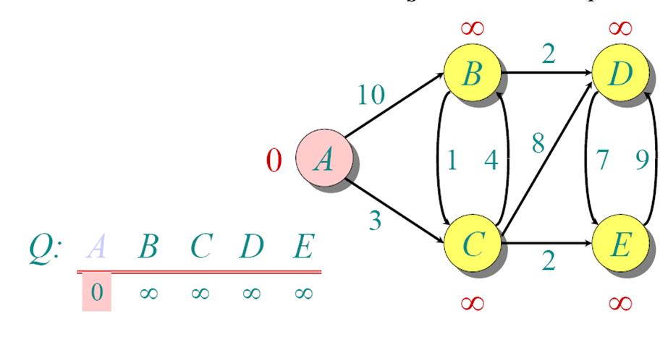
Dijkstra Another Example

Slide 33
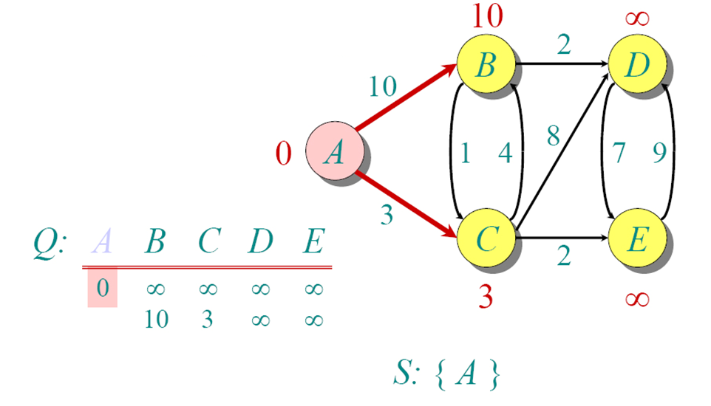
Dijkstra Another Example

Slide 34
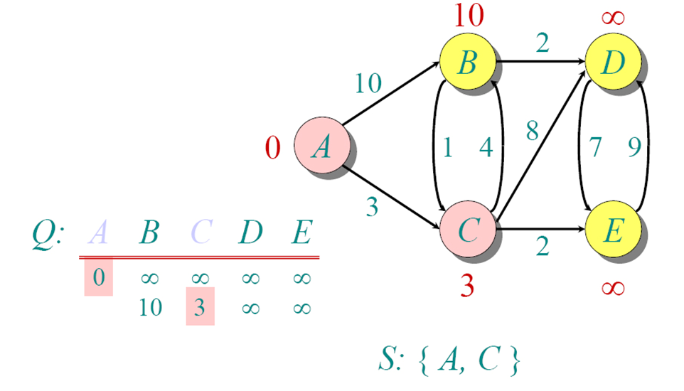
Dijkstra Another Example

Slide 35
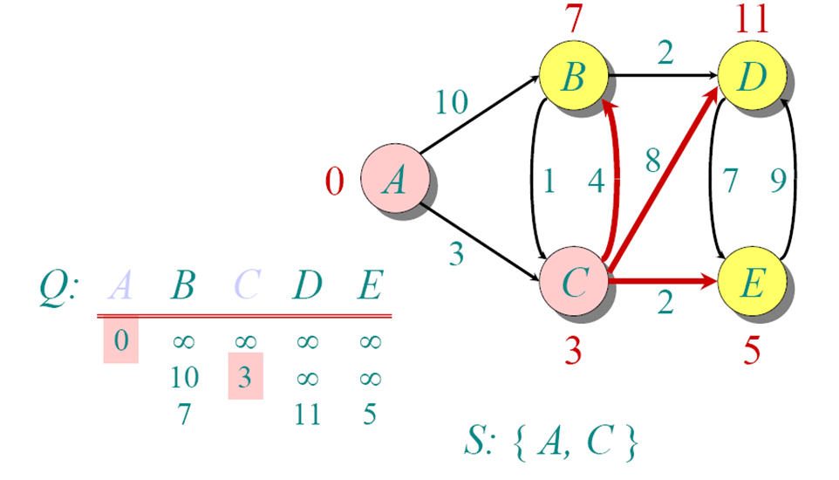
Dijkstra Another Example

Slide 36
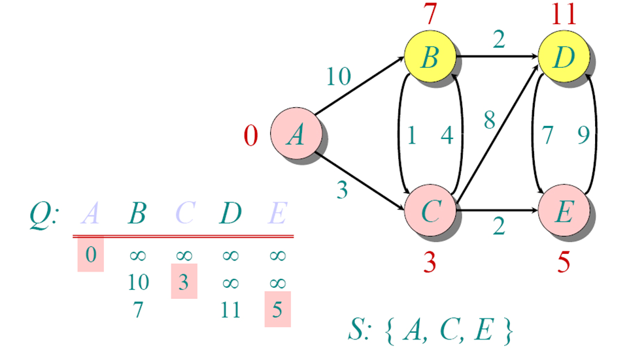
Dijkstra Another Example

Slide 37
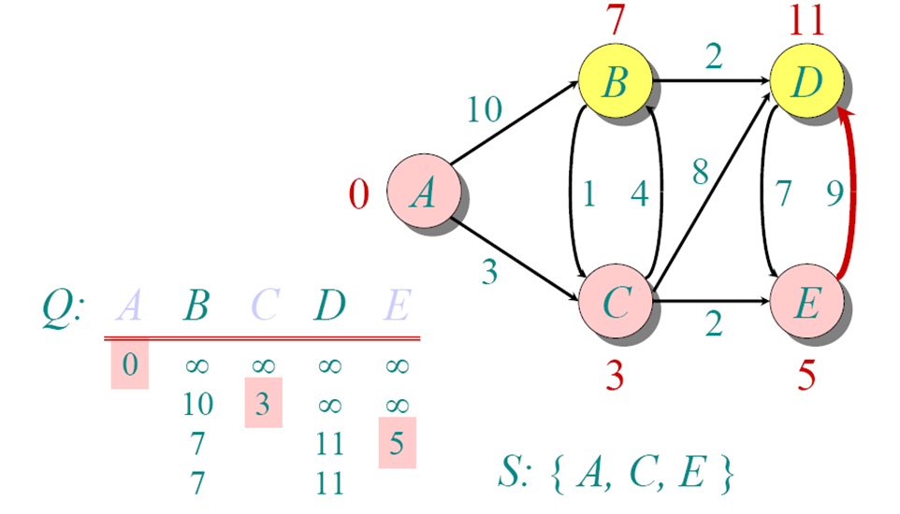
Dijkstra Another Example

Slide 38
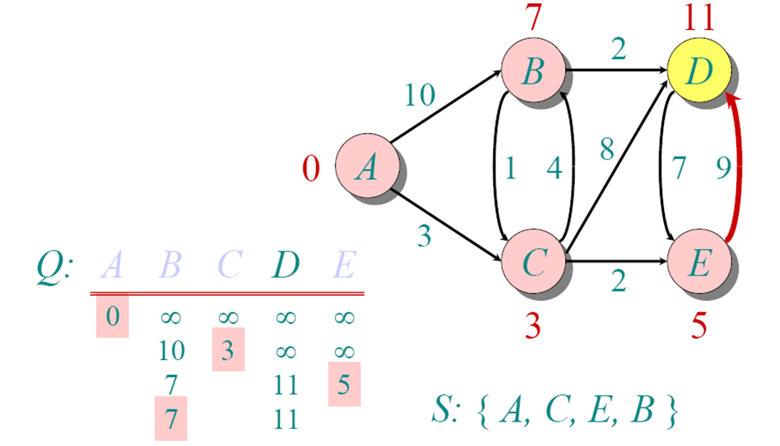
Dijkstra Another Example

Slide 39
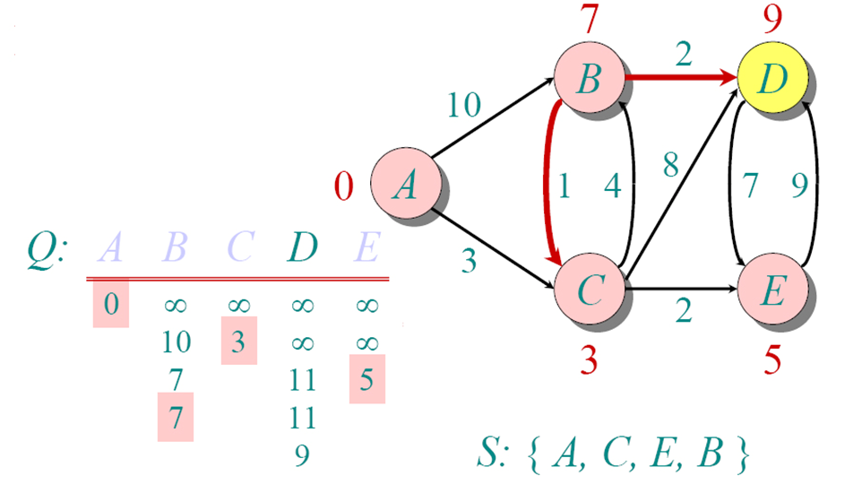
Dijkstra Another Example

Slide 40
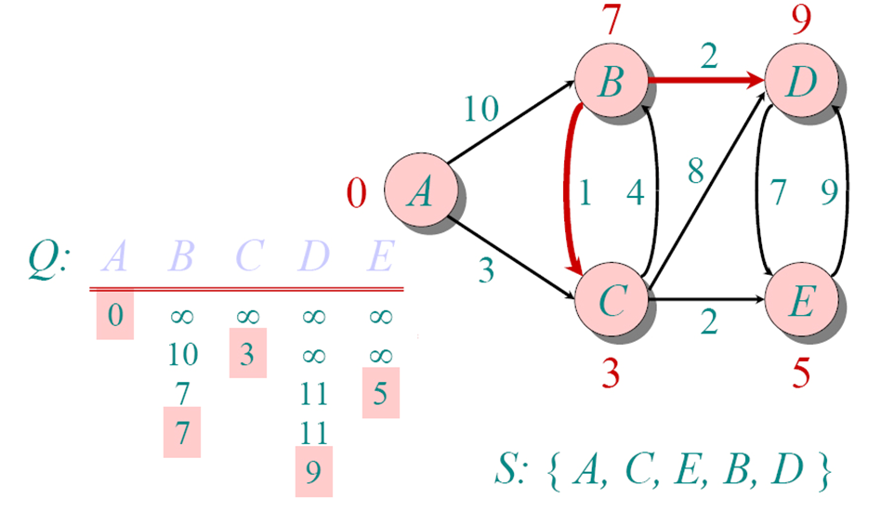
Dijkstra Another Example

Slide 41
Dijkstra's Algorithm - Summary
Non-negative edge weights
Greedy, similar to Prim's algorithm for MST
Like breadth-first search (if all weights = 1, one can simply use BFS)
Use Q, priority queue keyed by d[v] (BFS used FIFO queue, here we use a PQ, which is re-organized whenever some d decreases)
Basic idea
maintain a set S of solved vertices
at each step select "closest" vertex u, add it to S, and relax all edges from u

Slide 42
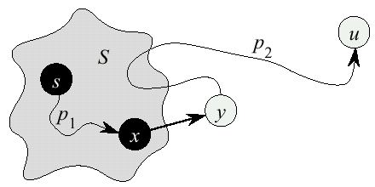
Dijkstra’s Correctness
We will prove that whenever u is added to S, d[u] = δ(s,u), i.e., that d is minimum, and that equality is maintained thereafter
Proof
Note that ∀v, d[v] ≥ δ(s,v)
Let u be the first vertex picked such that there is a shorter path than d[u], i.e., that ⇒ d[u] > δ(s,u)
We will show that this assumption leads to a contradiction

Slide 43
Dijkstra Correctness (2)
Let y be the first vertex ∈V – S on the actual shortest path from s to u, then it must be that d[y] = δ(s,y) because
d[x] is set correctly for y's predecessor x ∈S on the shortest path (by choice of u as the first vertex for which d is set incorrectly)
when the algorithm inserted x into S, it relaxed the edge (x,y), assigning d[y] the correct value

Slide 44
Dijkstra Correctness (3)
But d[u] > d[y] ⇒ algorithm would have chosen y (from the PQ) to process next, not u ⇒ Contradiction
Thus d[u] = δ(s,u) at time of insertion of u into S, and Dijkstra's algorithm is correct

Slide 45
The Bellman-Ford Algorithm
Handles negative edge weights
Detects negative cycles
Is slower than Dijkstra
4
-10
5
a negative cycle

Slide 46
Bellman-Ford: Idea
Repeatedly update d for all pairs of vertices connected by an edge.
Theorem: If u and v are two vertices with an edge from u to v, and s ⇒ u → v is a shortest path, and d[u] = δ(s,u),
then d[u]+w(u,v) is the length of a shortest path to v.
Proof: Since s ⇒u → v is a shortest path, its length is δ(s,u) + w(u,v) = d[u] + w(u,v). 

Slide 47
Why Bellman-Ford Works
On the first pass, we find δ (s,u) for all vertices whose shortest paths have one edge.
On the second pass, the d[u] values computed for the one-edge-away vertices are correct (= δ (s,u)), so they are used to compute the correct d values for vertices whose shortest paths have two edges.
Since no shortest path can have more than |V[G]|-1 edges, after that many passes all d values are correct.
Note: all vertices not reachable from s will have their original values of infinity. (Same, by the way, for Dijkstra).

Slide 48
Negative Cycle Detection
What if there is a negative-weight cycle reachable from s?
Assume: d[u] ≤ d[x]+4
d[v] ≤ d[u]+5
d[x] ≤ d[v]-10
Adding:
d[u]+d[v]+d[x] ≤ d[x]+d[u]+d[v]-1
Because it’s a cycle, vertices on left are same as those on right. Thus we get 0 ≤ -1; a contradiction. So for at least one edge (u,v),
d[v] > d[u] + w(u,v)
This is exactly what Bellman-Ford checks for.
x
4
u
-10
5
v

Slide 49
Bellman-Ford Algorithm
BellmanFord()
for each v ∈ V
d[v] = ∞;
d[s] = 0;
for i=1 to |V|-1
for each edge (u,v) ∈ E
Relax(u,v, w(u,v));
for each edge (u,v) ∈ E
if (d[v] > d[u] + w(u,v))
return “no solution”;
Relax(u,v,w): if (d[v] > d[u]+w) then d[v]=d[u]+w
Initialize d[], which
will converge to shortest-path value δ
Relaxation: Make |V|-1 passes,
relaxing each edge
Test for solution Under what condition
do we get a solution?

Slide 50
Bellman-Ford Algorithm
BellmanFord()
for each v ∈ V
d[v] = ∞;
d[s] = 0;
for i=1 to |V|-1
for each edge (u,v) ∈ E
Relax(u,v, w(u,v));
for each edge (u,v) ∈ E
if (d[v] > d[u] + w(u,v))
return “no solution”;
Relax(u,v,w): if (d[v] > d[u]+w) then d[v]=d[u]+w
What will be the
running time?

Slide 51
Bellman-Ford Algorithm
BellmanFord()
for each v ∈ V
d[v] = ∞;
d[s] = 0;
for i=1 to |V|-1
for each edge (u,v) ∈ E
Relax(u,v, w(u,v));
for each edge (u,v) ∈ E
if (d[v] > d[u] + w(u,v))
return “no solution”;
Relax(u,v,w): if (d[v] > d[u]+w) then d[v]=d[u]+w
What will be the
running time?
A: O(VE)

Slide 52
Bellman-Ford Algorithm
BellmanFord()
for each v ∈ V
d[v] = ∞;
d[s] = 0;
for i=1 to |V|-1
for each edge (u,v) ∈ E
Relax(u,v, w(u,v));
for each edge (u,v) ∈ E
if (d[v] > d[u] + w(u,v))
return “no solution”;
Relax(u,v,w): if (d[v] > d[u]+w) then d[v]=d[u]+w

Slide 53
Bellman-Ford Algorithm - Example
-2
5
6
-3
8
-4
7
7
2
9

Slide 54
Bellman-Ford Algorithm - Example
-2
∞
5
∞
6
-3
8
0
7
-4
7
2
∞
9
∞

Slide 55
Bellman-Ford Algorithm - Example
-2
6
5
∞
6
-3
8
0
7
-4
7
2
7
9
∞

Slide 56
Bellman-Ford Algorithm - Example
-2
6
5
4
6
-3
8
0
7
-4
7
2
7
9
2

Slide 57
Bellman-Ford Algorithm - Example
-2
2
5
4
6
-3
8
0
7
-4
7
2
7
9
2

Slide 58
Bellman-Ford Algorithm - Example
-2
2
5
4
6
-3
8
0
7
-4
7
2
7
9
-2

Slide 59
Bellman-Ford - Complexity
BellmanFord(graph (G,w), s)
InitializeSingleSource(G, s)
for i = 1 to |V| − 1 do
for (u,v) ∈ E do
Relax(u,v,w)
for (u,v) ∈ E do
if d[v] > d[u] + w(u,v) then
return false
return true
executed Θ(V) times
Θ(E)
Θ(1)
Θ(E)

Slide 60
So if Bellman-Ford has not converged after V(G) - 1 iterations, then there cannot be a shortest path tree, so there must be a negative weight cycle.

Slide 61
Example
u
v
5
∞
∞
–2
6
–3
8
z
0
7
–4
7
2
∞
∞
9
x
y
So if Bellman-Ford has not converged after V(G) - 1 iterations, then there cannot be a shortest path tree, so there must be a negative weight cycle.

Slide 62
Example
u
v
5
6
∞
–2
6
–3
8
z
0
7
–4
7
2
7
∞
9
x
y
So if Bellman-Ford has not converged after V(G) - 1 iterations, then there cannot be a shortest path tree, so there must be a negative weight cycle.

Slide 63
Example
u
v
5
6
4
–2
6
–3
8
z
0
7
–4
7
2
7
2
9
x
y

Slide 64
Example
u
v
5
2
4
–2
6
–3
8
z
0
7
–4
7
2
7
2
9
x
y

Slide 65
Example
u
v
5
2
4
–2
6
–3
8
z
0
7
–4
7
2
7
-2
9
x
y

Slide 66
DAG Shortest Paths
Problem: finding shortest paths in DAG
Bellman-Ford takes O(VE) time.
How can we do better?
Idea: use topological sort
If were lucky and processes vertices on each shortest path from left to right, would be done in one pass
Every path in a dag is subsequence of topologically sorted vertex order, so processing verts in that order, we will do each path in forward order (will never relax edges out of vert before doing all edges into vert).
Thus: just one pass. What will be the running time?

Slide 67
Shortest Paths in DAGs - SP-DAG
SP-DAG(graph (G,w), vertex s)
topologically sort vertices of G
InitializeSingleSource(G, s)
for each vertex u taken in topologically sorted order do
for each vertex v ∈ Adj[u] do
Relax(u,v,w)

Slide 68
Shortest Paths in DAGs - Example
6
1
5
2
7
-1
-2
4
3
2

Slide 69
Shortest Paths in DAGs - Example
6
1
5
2
7
-1
-2
∞
0
∞
∞
∞
∞
4
3
2

Slide 70
Shortest Paths in DAGs - Example
6
1
5
2
7
-1
-2
∞
0
∞
∞
∞
∞
4
3
2

Slide 71
Shortest Paths in DAGs - Example
6
1
5
2
7
-1
-2
∞
0
∞
∞
∞
∞
4
3
2

Slide 72
Shortest Paths in DAGs - Example
6
1
5
2
7
-1
-2
∞
0
2
6
∞
∞
4
3
2

Slide 73
Shortest Paths in DAGs - Example
6
1
5
2
7
-1
-2
∞
0
2
6
6
4
4
3
2

Slide 74
Shortest Paths in DAGs - Example
6
1
5
2
7
-1
-2
∞
0
2
6
6
4
4
3
2

Slide 75
Shortest Paths in DAGs - Example
6
1
5
2
7
-1
-2
∞
0
2
6
5
4
4
3
2

Slide 76
Shortest Paths in DAGs - Example
6
1
5
2
7
-1
-2
∞
0
2
6
5
4
4
3
2

Slide 77
Shortest Paths in DAGs - Example
6
1
5
2
7
-1
-2
∞
0
2
6
5
3
4
3
2

Slide 78
Shortest Paths in DAGs - Example
6
1
5
2
7
-1
-2
∞
0
2
6
5
3
4
3
2

Slide 79
SP in a DAGs - Complexity
SP-DAG(graph (G,w), s)
topologically sort vertices of G
InitializeSingleSource(G, s)
for each vertex u taken in topologically sorted order do
for each vertex v ∈ Adj[u] do
Relax(u,v,w)
T(V,E) = Θ(V + E) + Θ(V) + Θ(V) + E Θ(1) = Θ(V + E)

